Slide 1
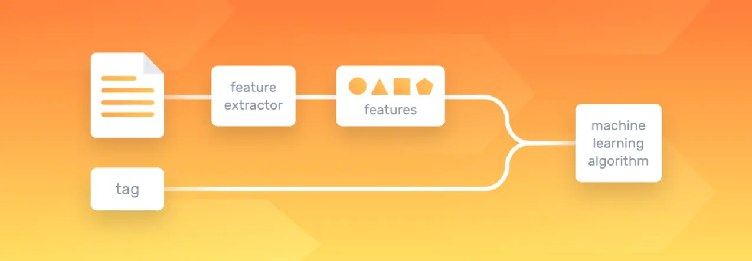
Machine Learning’s Natural Language Processing a theoretical insight with a few sample applications
Anton Georgescu
Principal Product Architect, TEMS
Standish, Ontario

Slide 2
A dilemma…
We have machine learning, and artificial intelligence
We have deep learning with neural networks that can understand, discover, predict, make decisions
We have powerful machines that run at speeds that our brains cannot even fathom
Do we still need geniuses among us, people like Albert Einstein and Stephen Hawking?
Find my take on that at https://www.linkedin.com/pulse/machine-learning-instead-einstein-anton-georgescu

Slide 3
Table of Content
What is Natural Language Processing (NLP)
Benefits of Natural Language Processing
How does Natural Language Processing work?
Natural Language Processing levels
Syntactic Analysis techniques & tasks
Text Vectorization
Semantic Analysis techniques & tasks
Natural Language Processing methods
Rule-based approach
Machine learning models
Natural Language Processing algorithms
Text Classification Algorithms
Text Extraction Algorithms
Topic Modeling Algorithms
Concrete applications of NLP
Natural Language Generation
Named Entity Recognition (NER)
Chatbots

Slide 4
What is Natural Language Processing (NLP)
Natural Language Processing (NLP) is a subfield of artificial intelligence that helps computers understand human language.
combines the power of linguistics and computer science to study the rules and structure of language
create intelligent systems capable of understanding, analyzing, and extracting meaning from text and speech
core of many popular applications:
translation software
chatbots
spam filters (Gmail, Yahoo email)
search engines (Google, Bing)
speech engines (Siri, Alexa, Google, Cortana)
grammar checking software
voice assistants
social media monitoring tools.

Slide 5
Benefits of NLP
Prepares text and speech for machines
so that they’re able to interpret, process, and organize information
bridges the gap between the way we talk and how computers decipher information
Large-scale analysis
allows the machines to perform language-based tasks such as reading text, identifying what’s important, extracting sentiment, or hearing speech, on a large scale.
Structuring unstructured data
human language is complex, varied, and ambiguous, while machine language relies on logical and highly structured languages and information
by using grammatical rules, algorithms, and statistics, it can interpret natural language and provide an appropriate response or action.

Slide 6
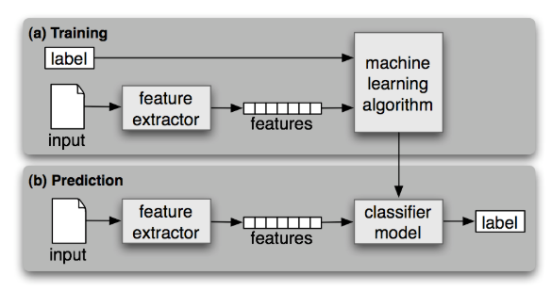
How does NLP work?
It is based on Supervised Classification learning, having *corpora as datasets
During training, a feature extractor is used to convert each input value to a feature set.
Pairs of feature sets and labels are fed into the machine learning algorithm to generate a model.
During prediction, the same feature extractor is used to convert unseen inputs to feature sets.
These feature sets are then fed into the model, which generates predicted labels.
*In linguistics and NLP, corpus (plural corpora) which is Latin for body, refers to a collection of texts.

Slide 7
Natural Language Processing Levels
Syntactic Analysis
also known as parsing or syntax analysis
studies the grammatical rules in natural language with the purpose of uncovering the structure of a text
Semantic Analysis
focuses on identifying the meaning of text
help understand the topic of a text, as it can identify the presence of related concepts
because language is polysemic and ambiguous, semantics is challenging

Slide 8
Syntactic Analysis techniques & tasks
Tokenization
convert the normal text strings into a list of tokens or words that will be used for refined search. Sentence tokenizer can be used to find the list of sentences and Word tokenizer can be used to find the list of words in strings.
Tokenization process is linked to text vectorization that has a few implementations (see next slides)
Stemming
process of reducing inflected (or sometimes derived) words to their stem, base or root form, generally a written word form (e.g. “Stems”, “Stemming”, “Stemmed”, and “Stemtization” are transformed into one word “stem”)
Lemmatization
variant of stemming. The major difference between these is, that, stemming can often create non-existent words, whereas lemmas are actual words. So, your root stem, meaning the word you end up with, is not something you can just look up in a dictionary, but you can look up a lemma
Stop Word Removal
remove extremely common words which would appear to be of little value in helping select documents matching a user need are excluded from the vocabulary entirely. These words are called stop words

Slide 9
Text Vectorization: Bag of Words
Text Vectorization comes after the initial preprocessing phase, when we need to transform the text into a meaningful vector (or array) of numbers. It is part of the larger “tokenization” step
The bag-of-words is a representation of text that describes the occurrence of words within a document. It involves two things:
A vocabulary of known words.
A measure of the presence of known words.
Why is it is called a “bag” of words? That is because any information about the order or structure of words in the document is discarded and the model is only concerned with whether the known words occur in the document, not where they occur in the document.
The intuition behind the Bag of Words is that documents are similar if they have similar content. Also, we can learn something about the meaning of the document from its content alone.
For example, if our dictionary contains the words {Learning, is, the, not, great}, and we want to vectorize the text “Learning is great”, we would have the following vector: (1, 1, 0, 0, 1).

Slide 10
Text Vectorization: Deep Learning
a neural network (NN) can “learn” good vector representations of words that have some desirable properties like being able to do math with them.
For example, with word2vec you can do “king” – “man” + “woman” and you get as a result a vector that is very similar to the vector “queen.”
next step is to get a vectorization for a whole sentence instead of just a single word, which is very useful if you want to do text classification for example.

Slide 11
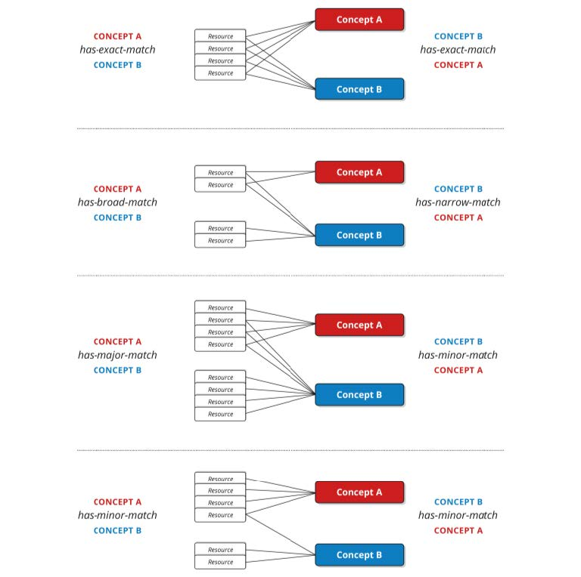
Semantic Analysis techniques & tasks
Word Sense Disambiguation (WSD)
an *open problem concerned with identifying which sense of a word is used in a sentence.
human brain is quite proficient at word-sense disambiguation, however the algorithms we use are not yet
supervised learning approaches have made some strides
Relationships
By grammatical relations (such as subject, direct object, indirect object) we understand structurally encoded standard syntactic relations between the constituents of a clause, in particular between the predicate and noun phrases.
* In science and mathematics, an open problem or an open question is a known problem which can be accurately stated, and which is assumed to have an objective and verifiable solution, but which has not yet been solved (i.e., no solution for it is known)

Slide 12
Natural Language Processing Methods
two main technical approaches to Natural Language Processing that create different types of systems
one is based on linguistic rules and the other on machine learning methods.
there is also the third one, hybrid approach, that combines both rule-based systems and machine learning systems
allows drawing benefit from the advantages of each of the two main approaches, and gain accuracy in your results.

Slide 13
Rule-Based Approach
hand-crafted system of rules based on linguistic structures that imitates the human way of building grammar structures.
can be developed in a very flexible manner, through the extension of translation rules and synonyms base
can easily be updated with new functions and data types
system doesn’t require a massive training corpus, compared to the machine learning-based approach.
obvious disadvantage of the rule-based approach is that it requires skilled experts (eg linguist)

Slide 14
Machine Learning Models
based on algorithms that learn to “understand” language without being explicitly programmed
use of statistical methods, where the system starts analyzing the training set (annotated corpus) to build its own knowledge, produce its own rules and its own classifiers.
good at tasks such as document classification or word clustering from a corpus, because in both cases there are a lot of data points (e.g. keywords etc), which makes it easy for the machine to learn statistical clues of the words for a given task.

Slide 15
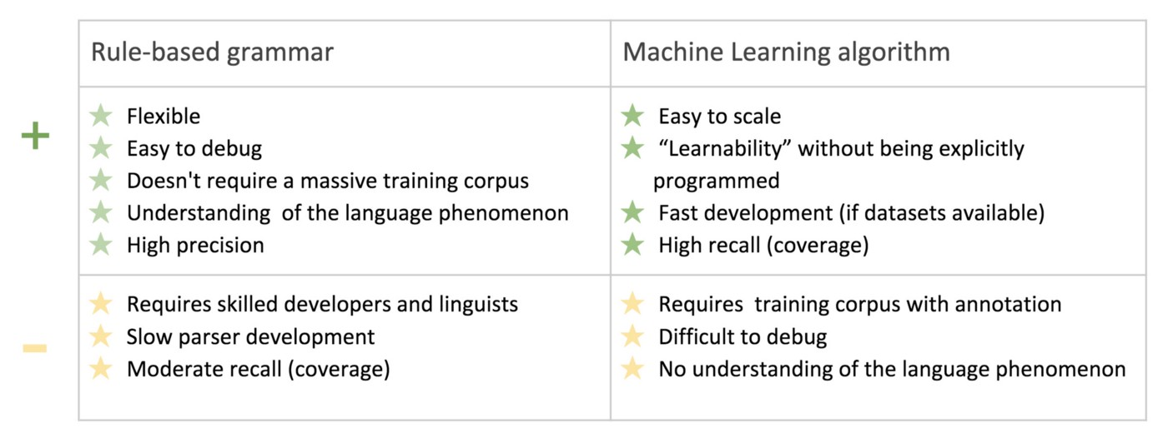
Rule-based vs Machine learning

Slide 16
Text Classification Algorithms
Naive Bayes
texts have to be transformed into vectors (list of numbers) before classification
numbers will help the algorithm decide whether the vector representation of a text belongs to a category or not
encode in vectors the probability of belonging of a word or a sequence of words of length n (also known as n-gram) to a category
Naïve Bayes identifies the probability of a feature, based on prior knowledge of conditions that might be related to that feature.
Vary good example at https://monkeylearn.com/blog/practical-explanation-naive-bayes-classifier/

Slide 17
Text Classification Algorithms
Support Vector Machines (SVM)
like Naïve Bayes, SVM doesn’t need much training data to start providing accurate results.
draws a “line” or hyperplane that divides a space into two subspaces: one subspace that contains vectors that belong to a group and another subspace that contains vectors that do not belong to that group
vectors are representations of your training texts and a group is a tag you have tagged your texts with
Deep Learning with Deep Neural Networks (DNN)

Slide 18
Text Classification Algorithms
Deep Learning with Deep Neural Networks (DNN)
two main deep learning architectures used in text classification are Convolutional Neural Networks (CNN) and Recurrent Neural Networks (RNN)
algorithms such as Word2Vec or GloVe are used in order to obtain better vector representations for words and improve the accuracy of classifiers trained with traditional machine learning algorithms

Slide 19
Metrics & Evaluation
Cross-validation
is a common method to evaluate the performance of a text classifier. It consists in splitting the training dataset randomly into equal-length sets of observations
Performance metrics that are useful for a quick assessment on how well a classifier works
Accuracy: the percentage of texts that were predicted with the correct tag.
Precision: the percentage of examples the classifier got right out of the total number of examples that it predicted for a given tag.
Recall: the percentage of examples the classifier predicted for a given tag out of the total number of examples it should have predicted for that given tag.
F1 Score: the harmonic mean of precision and recall.

Slide 20
Text Extraction Algorithms
TF with IDF (term frequency-inverse document frequency)
is a scoring of how rare the word is across documents.
Tf-IDF weight is a weight often used in information retrieval and text mining. This weight is a statistical measure used to evaluate how important a word is to a document in a collection or corpus
TF with Cosine Similarity
TF-IDF is a transformation applied to texts to get two real-valued vectors in vector space. We can then obtain the Cosine similarity of any pair of vectors by taking their dot product and dividing that by the product of their norms. That yields the cosine of the angle between the vectors. Cosine similarity is a measure of similarity between two non-zero vectors
Regular Expressions (regex)
set of characters, or a pattern, which is used to find sub strings in a given string
for example, extract all hashtags from a tweet, get email id or phone numbers etc.
Rapid Automatic Keyword Extraction (RAKE)
extraction algorithm which tries to determine key phrases in a body of text by analyzing the frequency of word appearance and its co-occurance with other words in the text.

Slide 21
Topic Modeling Algorithms
Latent Semantic Analysis (LSA)
Text data suffers heavily from high-dimensionality.
Latent Semantic Analysis (LSA) is a popular, dimensionality-reduction techniques that follows the same method as Singular Value Decomposition (SVD)
SVD is a computational method often employed to calculate principal components for a dataset
efficient implementation of principal component analysis (PCA)
Latent Dirichlet Allocation (LDA)
unsupervised machine-learning model that takes documents as input and finds topics as output.
this model also says in what percentage each document talks about each topic.

Slide 22
Concrete applications of NLP
Text classification
* Sentiment analysis
* Topic classification
Intent detection
Text Extraction
* Keyword extraction
* Named Entity Recognition (NER)
Topic Modeling
Automatic Summarization
Machine Translation
Natural Language Generation
* Chatbots
* These topics are touched by the hands-on demos attached to this presentation

Slide 23
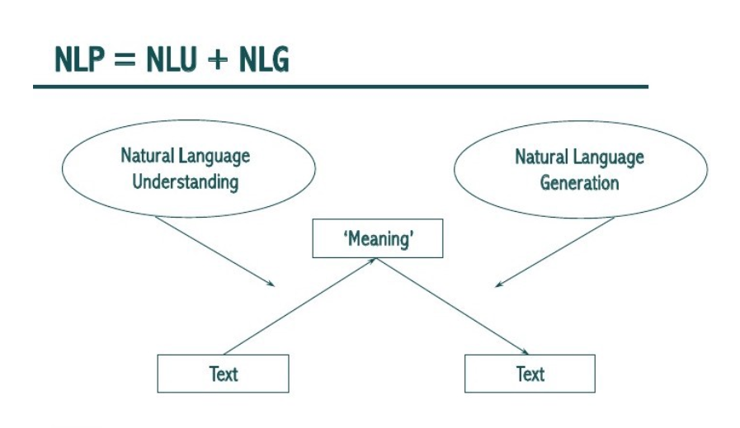
Natural Language Generation
NLP — Natural Language “Processing”
NLU — Natural Language “Understanding”
NLG — Natural Language “Generation”

Slide 24
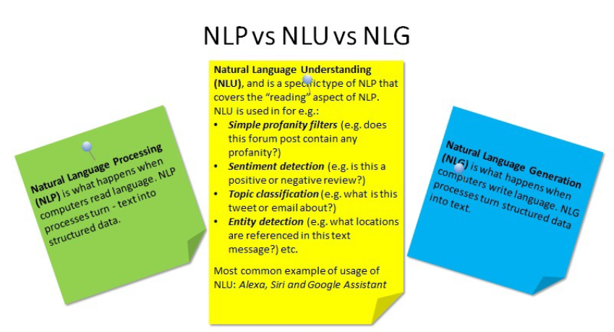
Natural Language Generation (cont’d)
NLU takes up the understanding of the data based on grammar, the context in which it was said and decide on intent and entities.
NLP will convert the text into structured data.
NLG generates text generated based on structured data.

Slide 25
Text Extraction: Named Entity Recognition (NER)
Intents:
Intents are nothing but verbs (activities that the user needs to do). If we want to capture a request, or perform an action, use an intent. In the example play is the intent.
Entities:
Entities are the nouns or the content for the action that needs to be performed. In this case, cricket is a noun.
It is possible to have multiple intents (like checking the weather, checking ground available, checking friends availability) for a single entity playing and also multiple entities for intent and multiple intents for multiple entities.

Slide 26
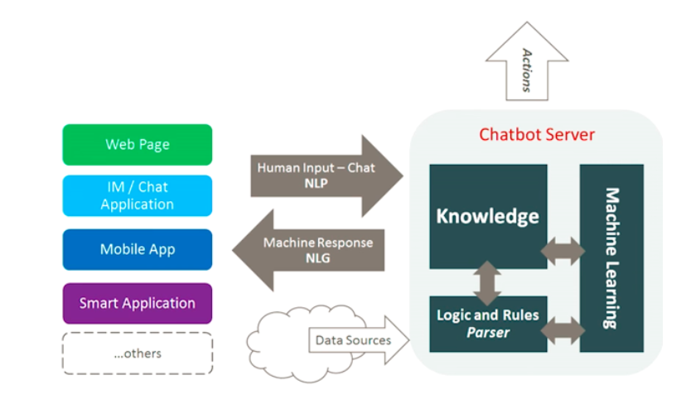
What are chatbots?
A chatbot is a computer program which conducts a conversation via auditory or textual methods.
Chatbots are typically used in dialog systems for various practical purposes including customer service or information acquisition.
Some chatterbots use sophisticated natural language processing systems, but many simpler systems scan for keywords within the input, then pull a reply with the most matching keywords, or the most similar wording pattern, from a database.

Slide 27
How do chatbots work?
There are 2 variants of chatbots
Rule-based approach, a bot answers questions based on some rules on which it is trained on. The rules defined can be very simple to very complex. The bots can handle simple queries but fail to manage complex ones.
Self-learning bots are the ones that use some Machine Learning-based approaches and are definitely more efficient than rule-based bots. These bots can be of further two types:
Retrieval Based - a chatbot uses some heuristic to select a response from a library of predefined responses. Heuristics for selecting a response can be engineered in many ways, from rule-based if-else conditional logic to machine learning classifiers.
Generative - can generate the answers and not always replies with one of the answers from a set of answers. This makes them more intelligent as they take word by word from the query and generates the answers.

Slide 28
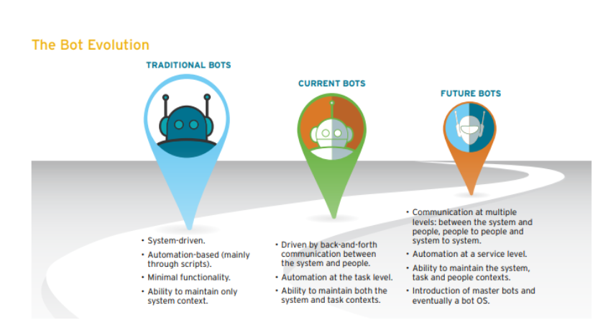
Evolution of bots

Slide 29
NLP with Python: NLTK package
NLTK (Natural Language Toolkit) is a leading platform for building Python programs to work with human language data.
It provides easy-to-use interfaces to over 50 corpora and lexical resources such as WordNet, along with a suite of text processing libraries for classification, tokenization, stemming, tagging, parsing, and semantic reasoning, wrappers for industrial-strength NLP libraries.

